Slide 1

ARDUINO
-PRESS START-

Slide 2


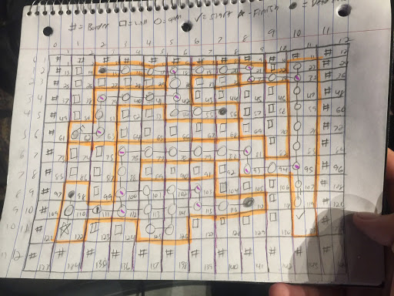
OUR HACK YSU PROJECT IS…
A maze game!
But it’s a maze, with a TWIST!

Slide 3
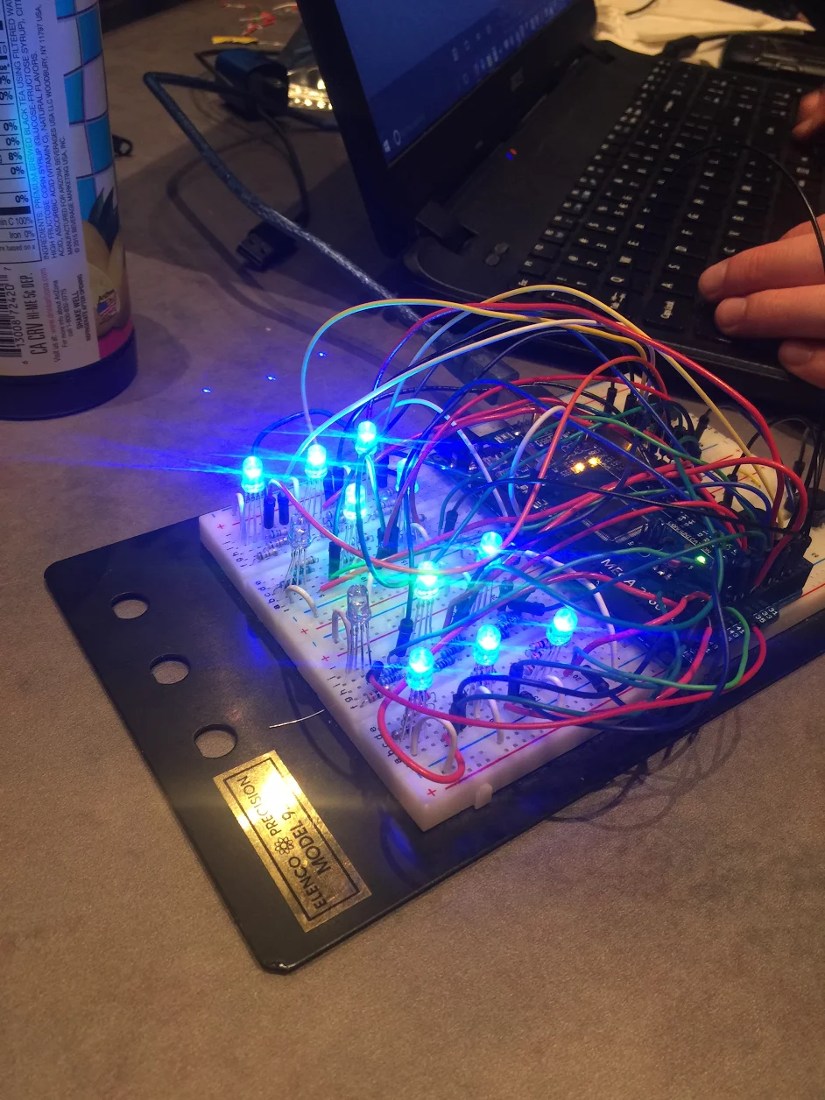
Our game has… little perspective
Our game uses an Arduino Mega 2560 and hardware to create a basic controller and user lay out
The 3x4 light board creates a rectangle where the center two bulbs represent the player, and the other 10 represent walls or open spaces the player could potentially move into.
This gives a feeling of immersion in that the player is lost in the maze, and has to remember the layout if they plan on winning the game, much like if they were in an actual maze

Slide 4

What do the colors mean?
Each bulb’s color has a different meaning
EASY
GREEN- Player
BLUE- Walls
BLANK(Bulb switched Off)- Open space
RED- You are dead
HARD MODE
GREEN – PLAYER
RED- DANGER ZONE
BLANK(BLANK BLUB)- OPEN SPACE

Slide 5
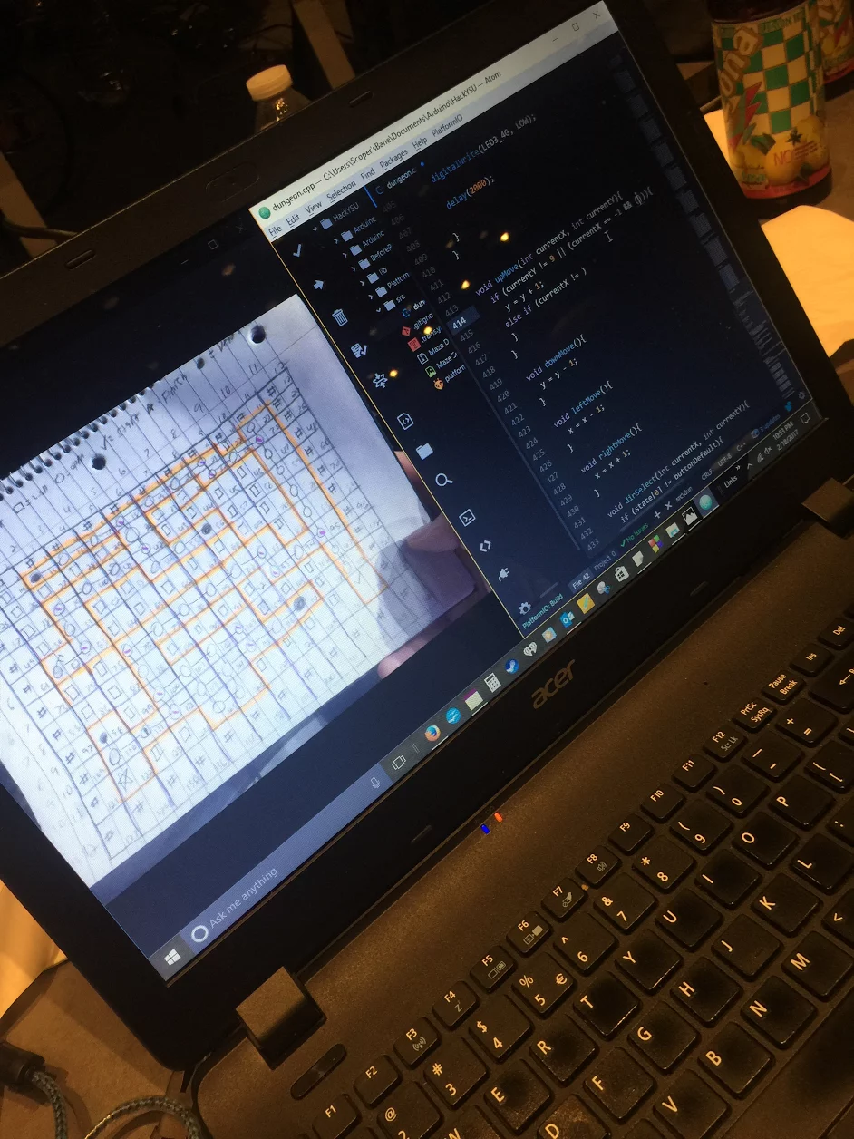
How it works
First we had designed the maze on paper.
Next we had coded separate functions for each different maze room and the light colors and orientation for the bulbs in the C++
Finally, after the code is read, the player orientation is light up on the Breadboard to show the player’s movement options.

Slide 6
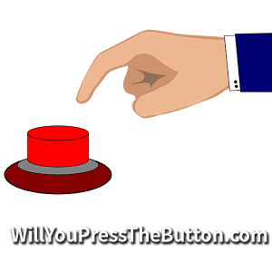
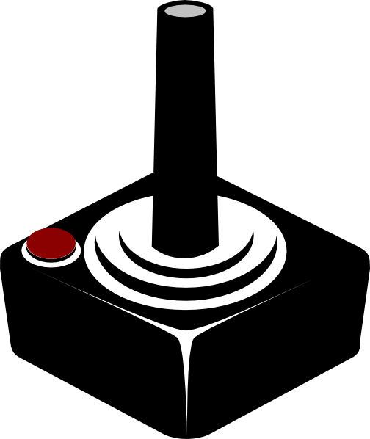
How the Buttons work
Each of the four buttons modify the X and Y positions for the player.
Pressing up or down will modify the Y position of the player, by either adding one (up) or subtracting one (down). Then printing a new maze tile based on X and Y positions
While pressing left or right will modify the X position. The X position has one subtracted from it (Left) or added to it (Right).

Slide 7
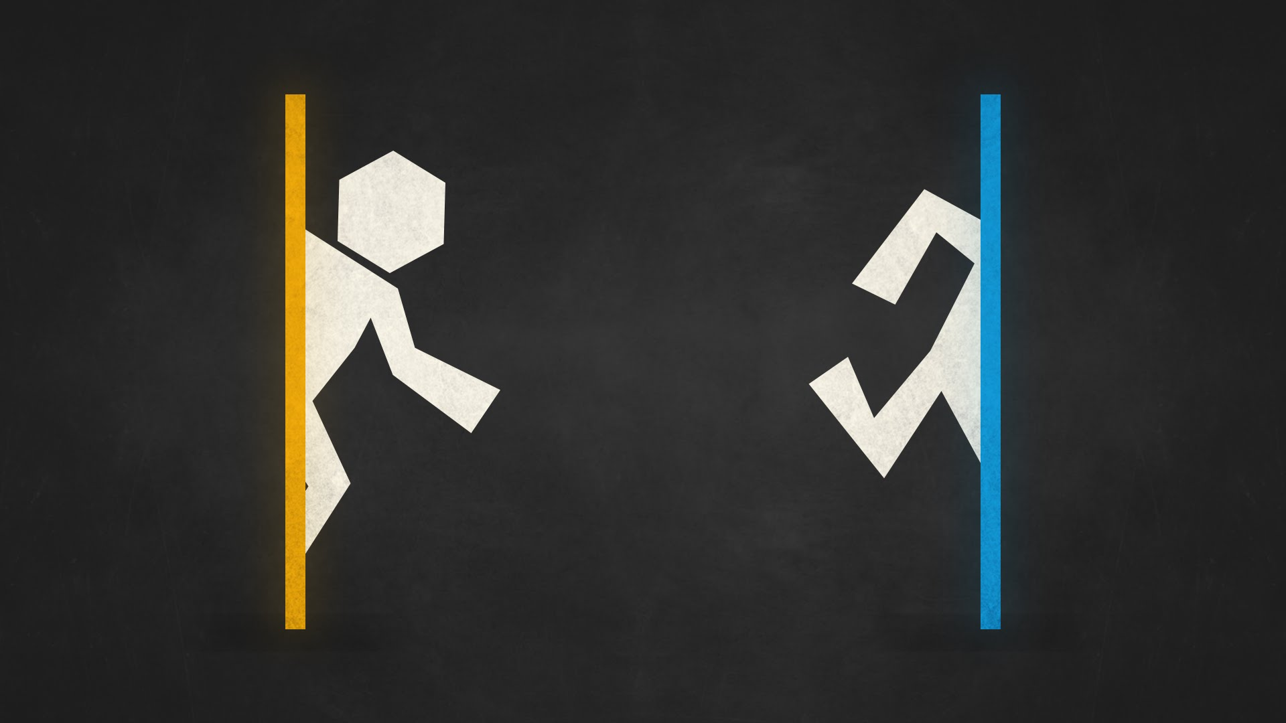
MOVING, AND YOU
The player moves around this dungeon by pressing the buttons.
And LED turned off represents open spaces they could move into
If a play runs into a wall, on easy, they revert back to the beginning of the maze, on hard mode they die and become demoralized

Slide 8
Works Cited:
WHAT IS ARDUINO? (n.d.). Retrieved February 19, 2017, from https://www.arduino.cc/

Slide 9
Names of Developers
Anthony Hake
Dominik Pavetic
James Hayes
Alexander Bonnette
Vincent Yacono

